Slide 1
Amazing Beach FRONT PROPERTy FOR SALE in Busuanga island - Palawan

Slide 2

PALAWAN
Palawan has always been included in the Top 10 Most Beautiful Islands in the World. Thus the average prices of properties in this area is around Php 7,000 per sqm.
According to this TourScanner, the No 1 meta-search engine for tours & travel activities, it’s the top 1 among the 30 Best Paradise Islands you should visit in the world for 2019:
https://tourscanner.co/blog/paradise-islands-you-should-visit-2018/

Slide 3

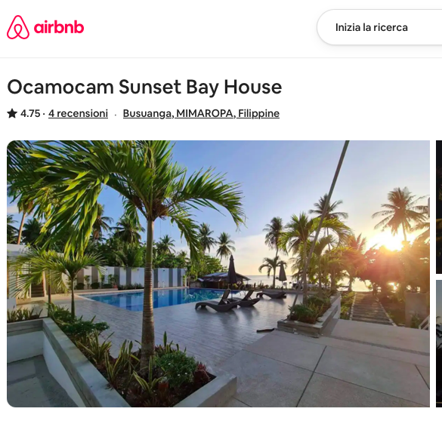
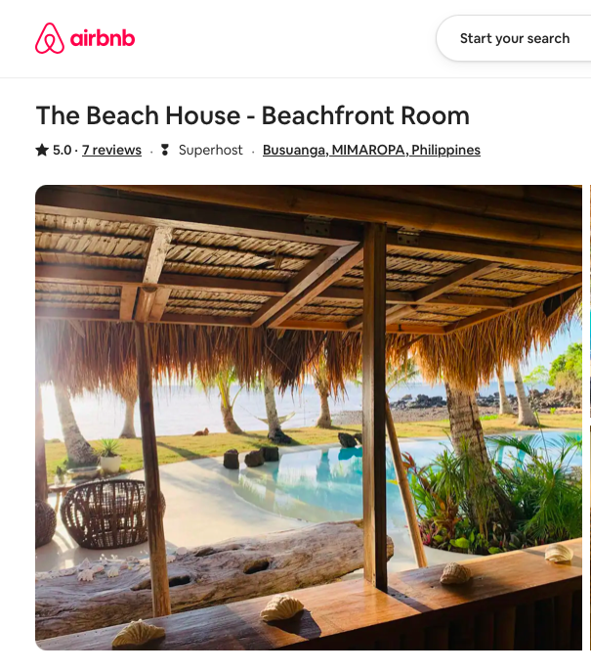
The Hotel developments on Ocamocam beach
The beach of Ocamocam is facing a huge development because of its natural pristine beauty that make this beach one of the most visited location on the island of Busuanga. It is normal to see tourists, based in Coron, renting a motorbike and coming to Ocam to spend a whole day of relax enjoying the beach-life that is possible only there.
Those are the already existing hotel structures where tourists can enjoy their holidays:

Slide 4
The future of Ocamocam, why to invest there ?
There are at leat two reason to invest in Ocamocam : there is a new airport already in costruction which will be an international one.
This will be a huge game changer for the island of Busuanga but, being Coron already way too crowded and cemented, the new wave of tourists (especially those with high spending capacity) will need to find a place where they can enjoy the tropical feeling of a natual beach. And this will be Ocamocam !
Please read this article about the beginning of the airport’s construction works written on the 12th March 2019 :
https://palawan-news.com/caap-breaks-ground-in-coron-for-p953m-busuanga-airport-devt-project/?fbclid=IwAR0fAE241Ds7y-GyPTkplMl4Obv5-mWLVVdEYp5R91GYvy0XEAi5Z-psE68

Slide 5
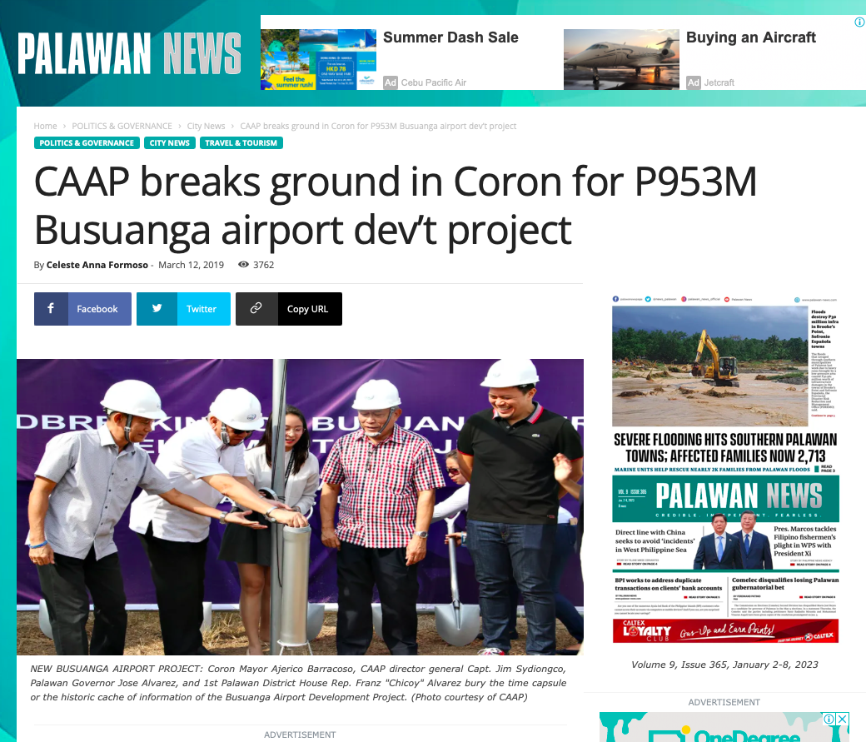

Slide 6
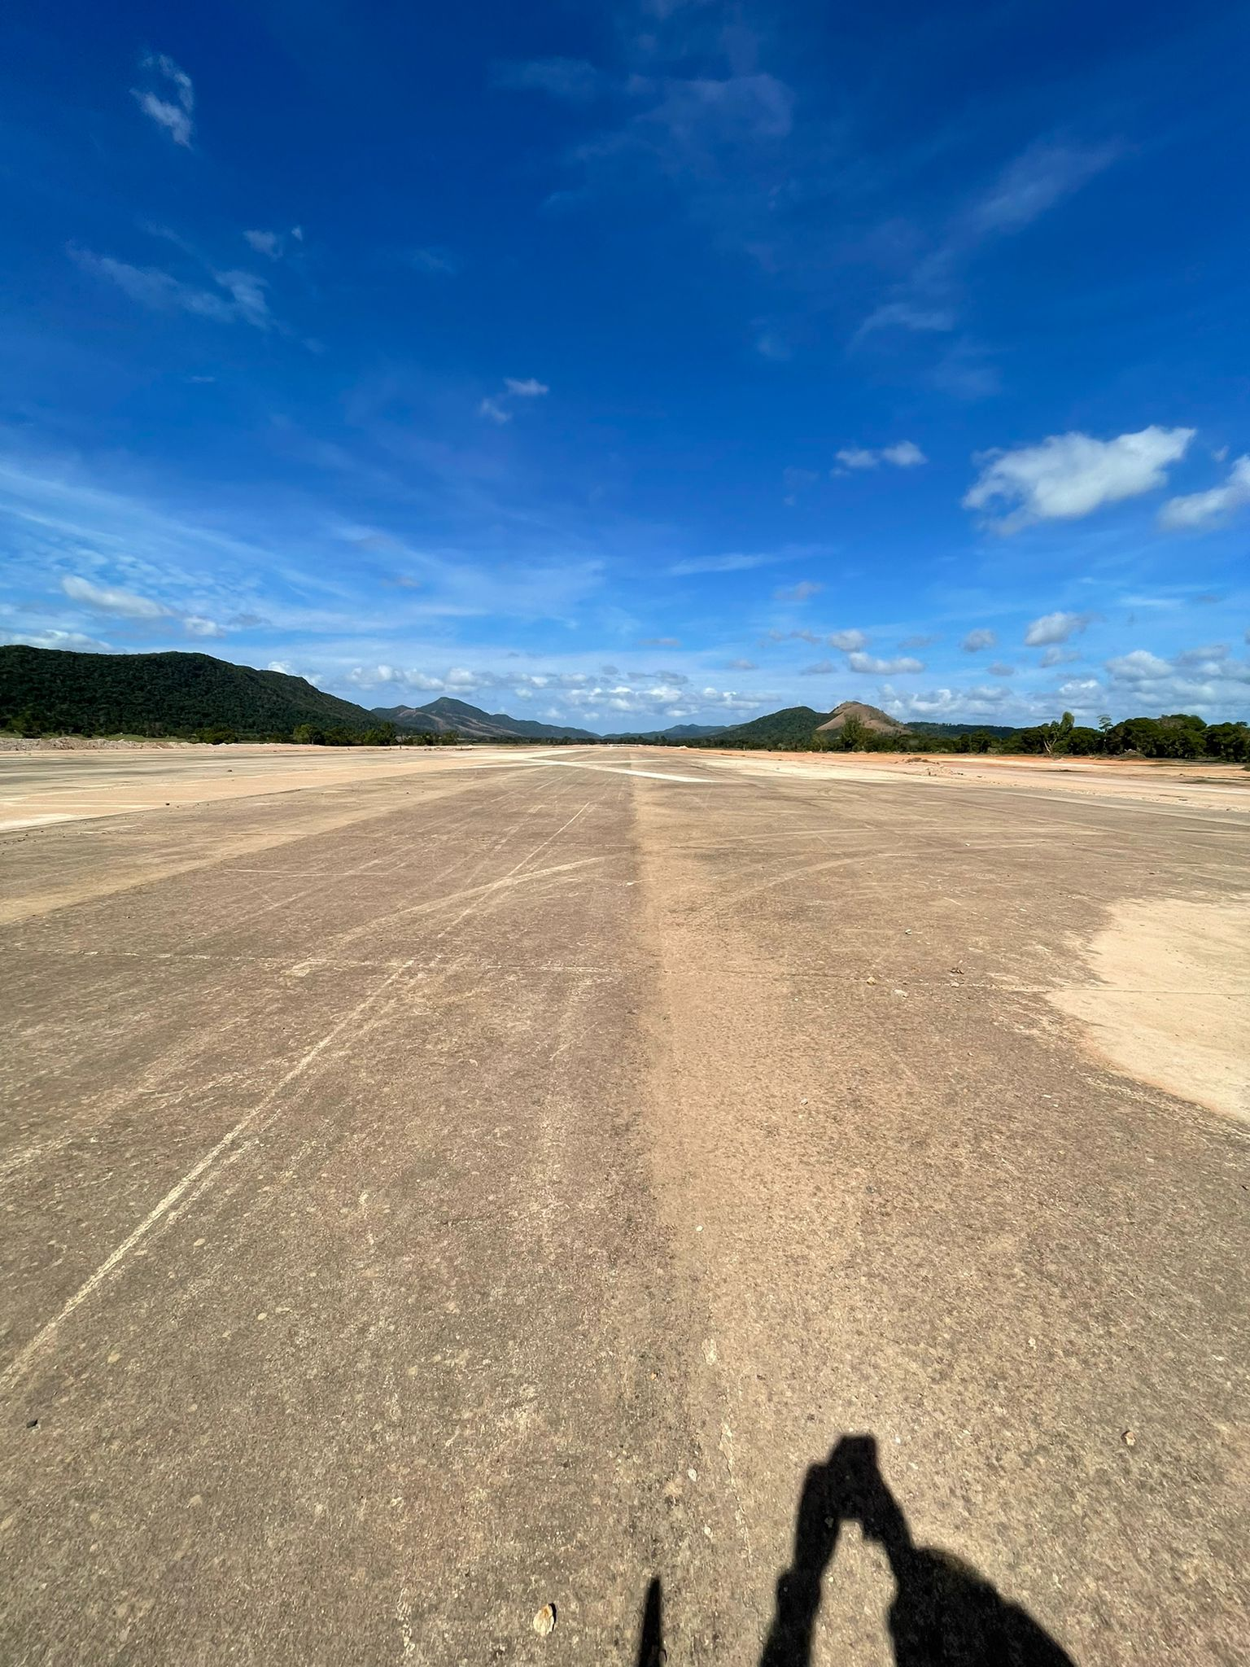
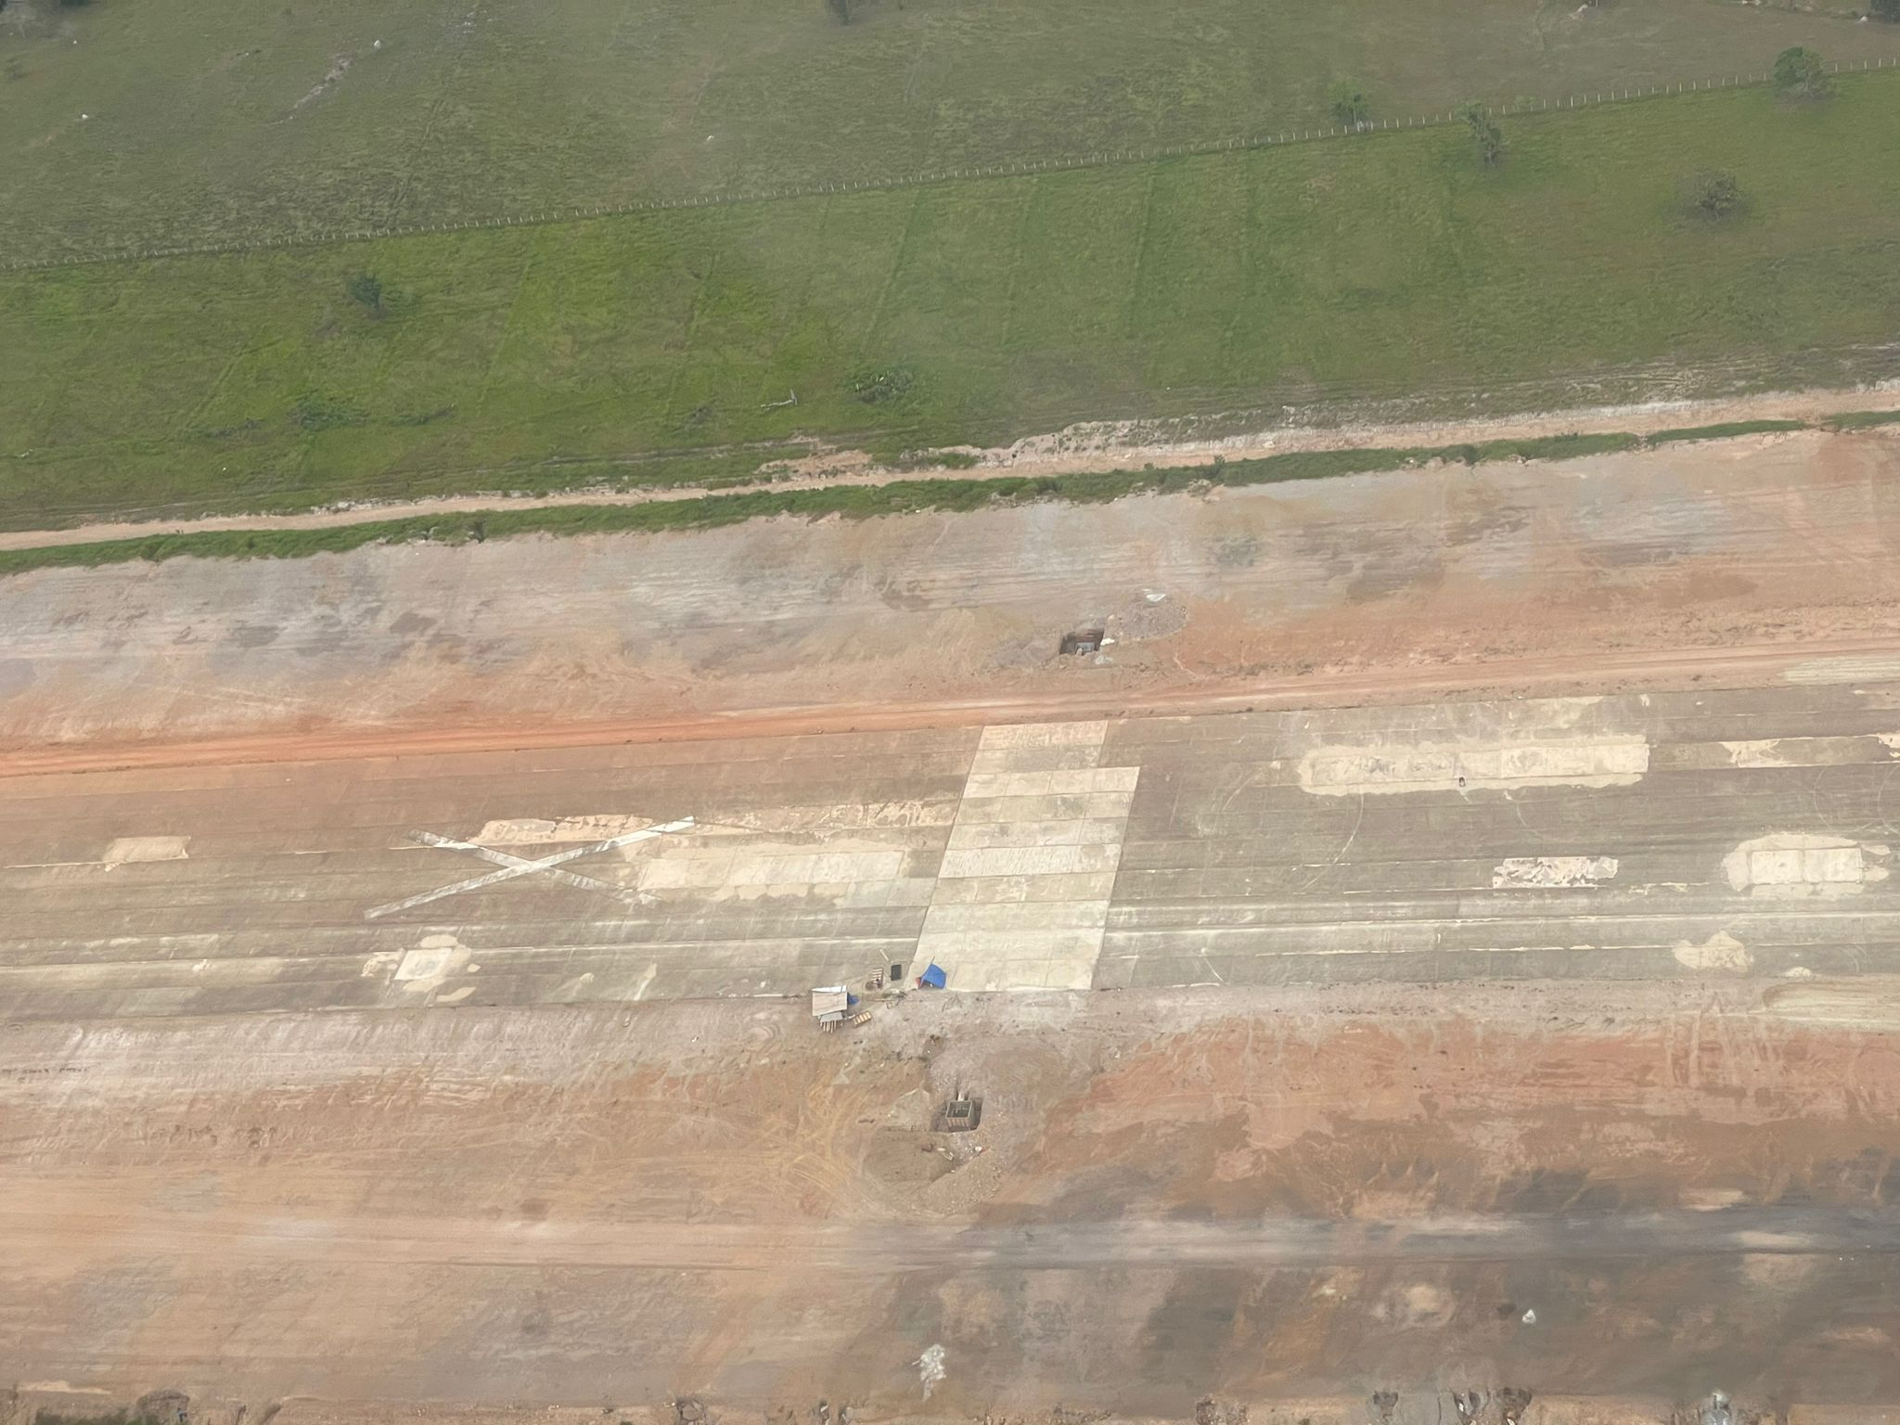
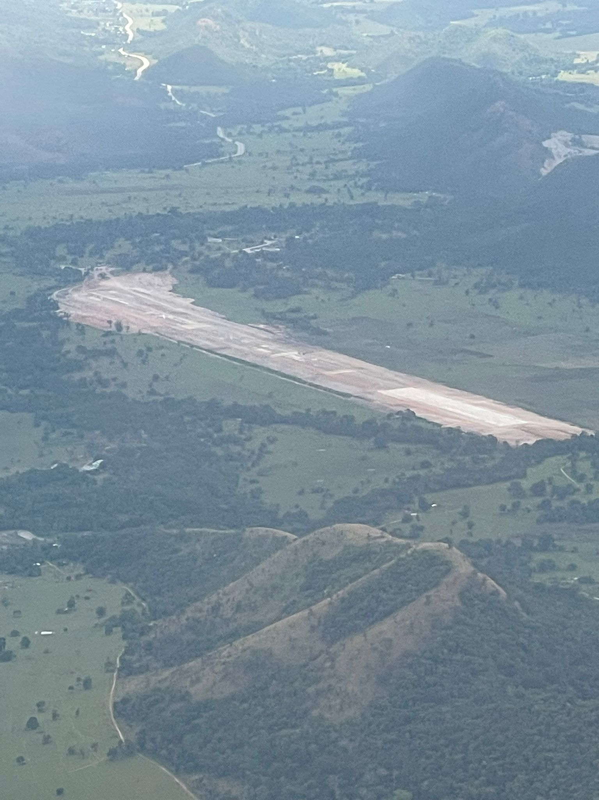
Pictures of the new airport construction (taken Feb. 2023)

Slide 7
The construction of a new sea port close to Ocamocam
There is already another very promising project that will make Ocamocam beach even more attractive for investors : the construction of a new Port which will start in March 2023 . The new harbour will be for both cargo handling and passanger terminal.
For sure cruise ships will dock there and our beach is just less then 1 Km away , on the other side of the little peninsula. Easy to imagine where the tourists, once disembarked, will naturally go.
This is the website of the new port :
https://busuangaport.com

Slide 8
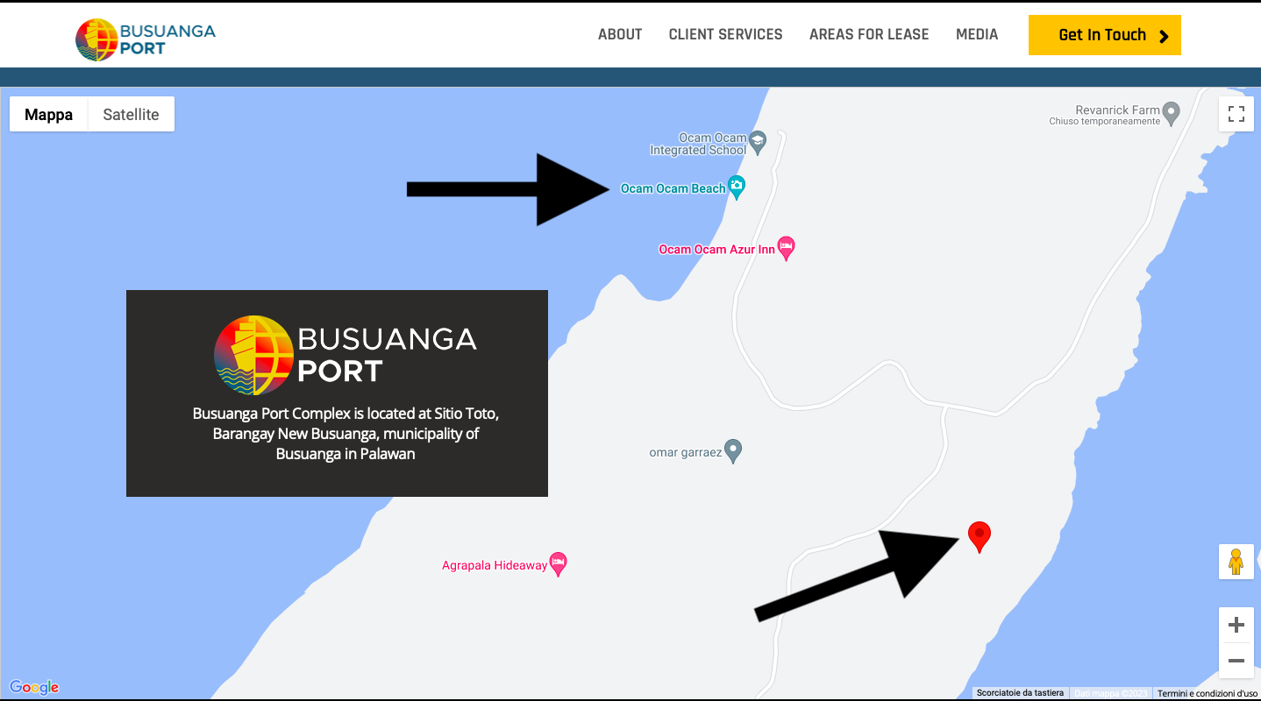
https://busuangaport.com

Slide 9
Our property in Ocamocam
The property is located in Ocamocam Beach - New Busuanga, BUSUANGA Island, PALAWAN Province, and is one of the emerging tourist destination on the island of Busuanga. Ocamocam beach is a top destination you can find in all the tourist packages offered by the local tourist agencies.
It is reachable by car within 50 mins from the Coron airport. The beach property is more than 31,000 squared meters big and it consists of 10 fully titled lots facing the sunset. It is the ideal location for a high-end resort development.

Slide 10
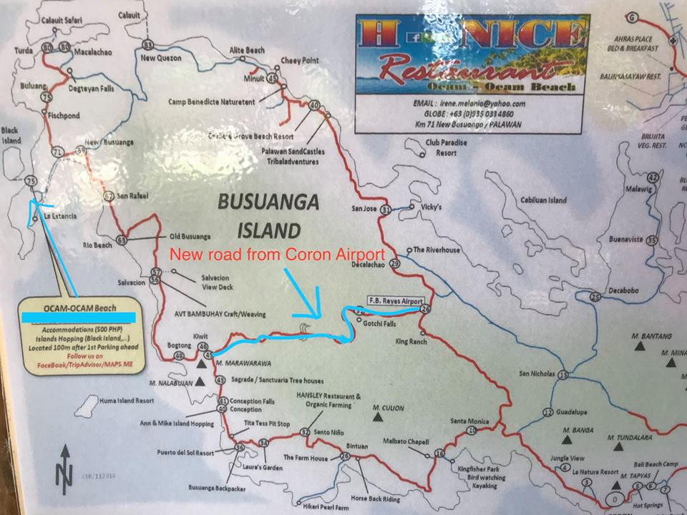
The newly built cemented road connecting Ocamocam to the airport. It takes 50 minutes car ride from the airport to our property.

Slide 11
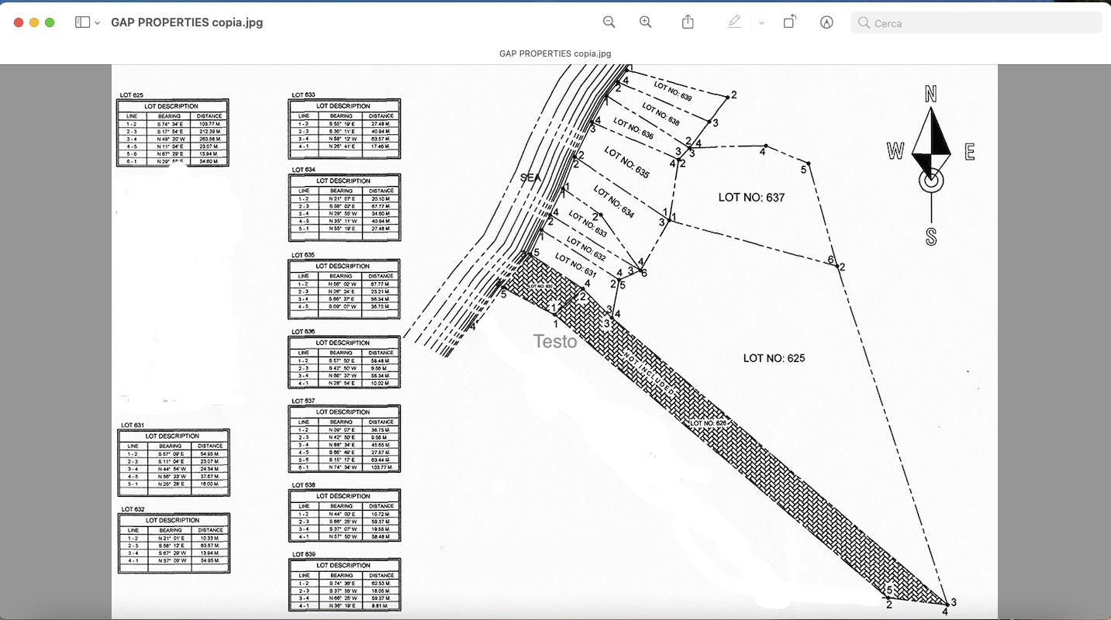
Our property
As said our property is 3,1 hectares big and it consists of 10 different titles all under the name of our Corporation.

Slide 12
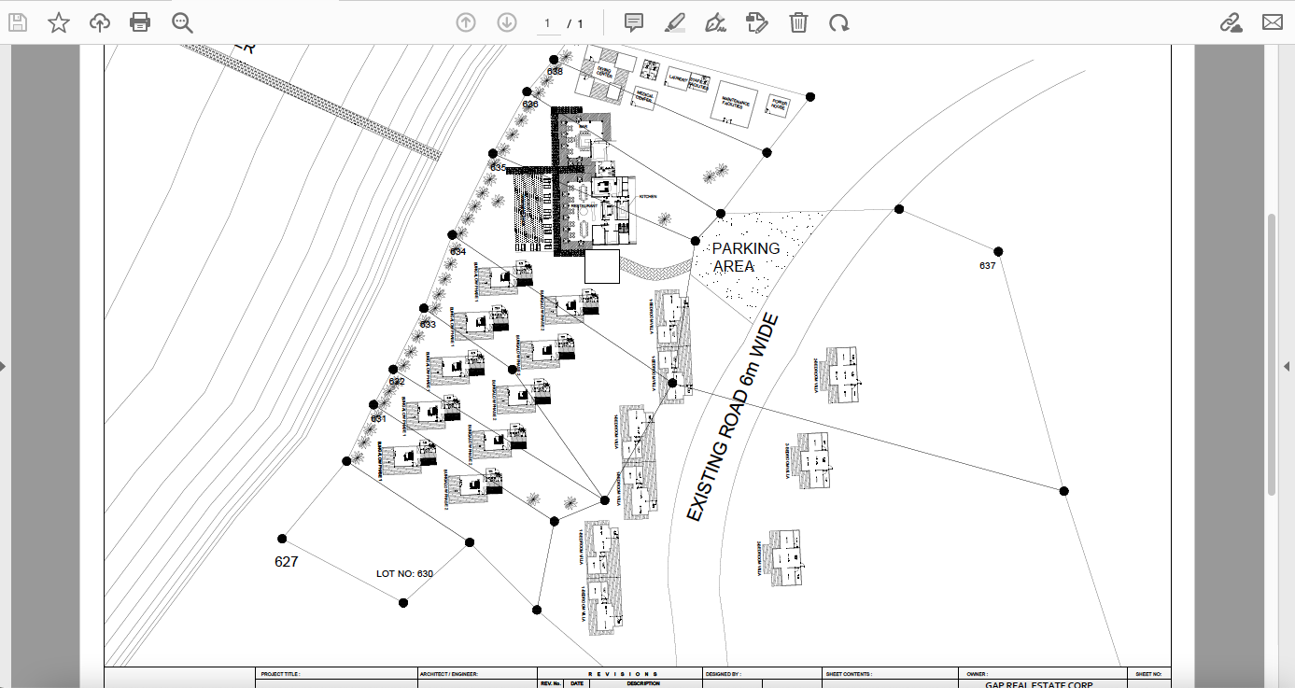
Our original construction plan

Slide 13
Beach Front
Right in front of the property there is a 140 mt. long clear sand beachfront and on the back side there is a portion of a small hill. The land has lots of greens from palm trees, coconut and fruit trees to tropical flowers and plants.
The property is undoubtedly located in a very prime spot and is for sure the best location you can find in the whole of Ocamocam beach , which is more than 1km long.
All the other properties on Ocamocam beach are smaller than and are no longer available for sale. They are mainly owned by foreigners.

Slide 14
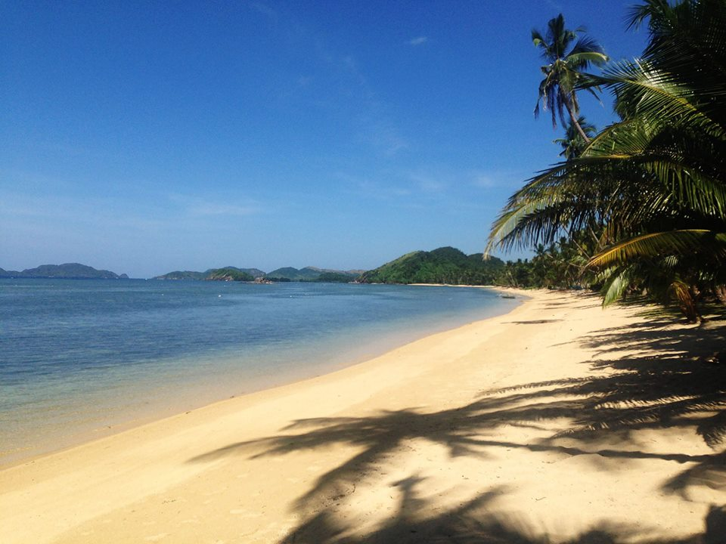

Slide 15
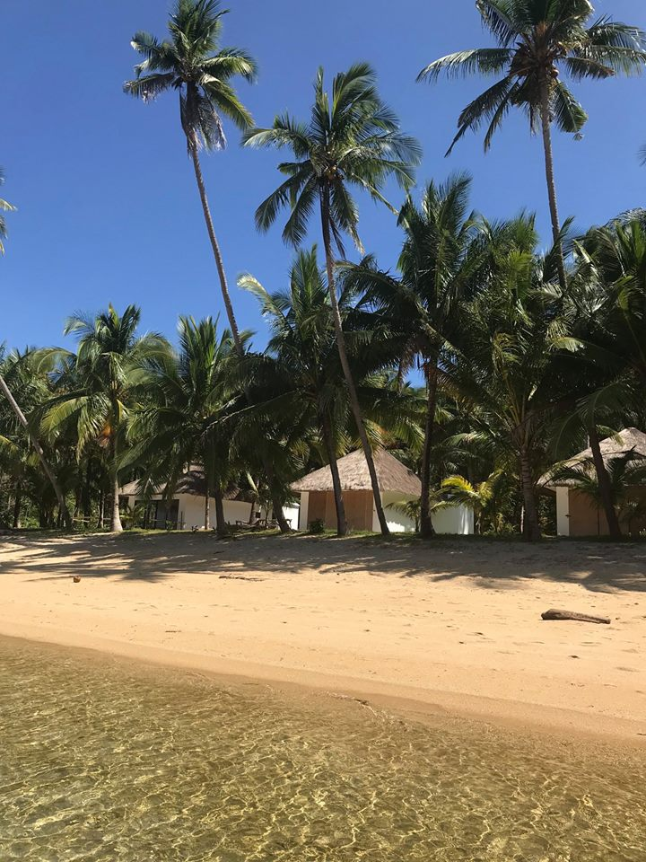

Slide 16
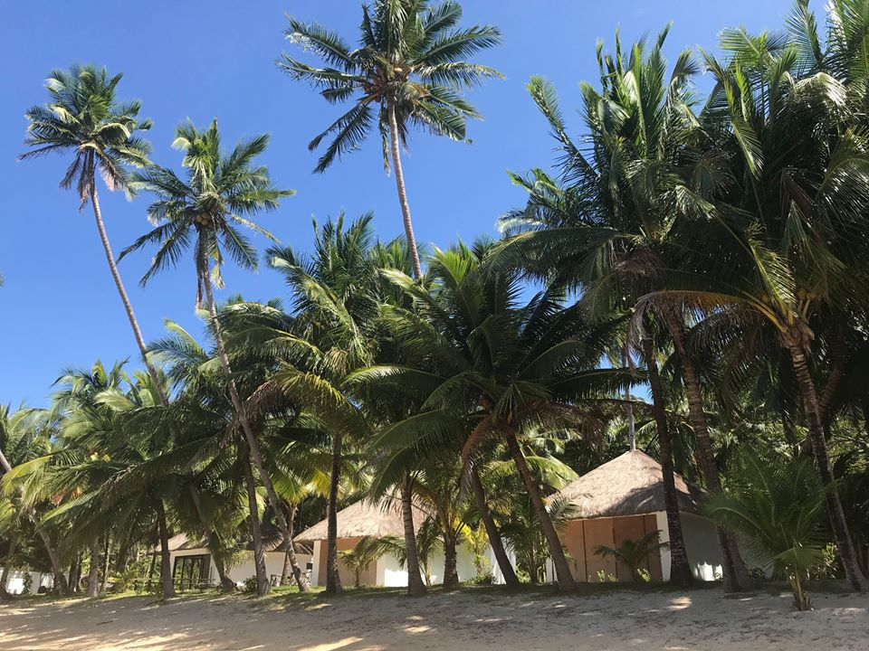

Slide 17
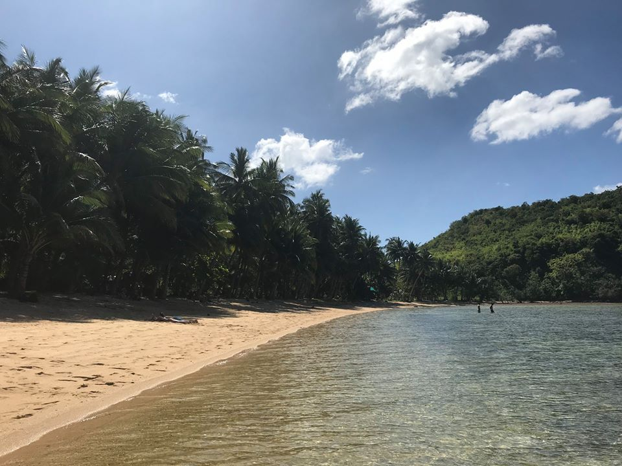

Slide 18
READY TO BUILD
The first advantage in buying this property, especially for non Filipino citizens, is that they can sell the whole Corporation, which is the owner of the land. This will make the whole process of buying land in the Philippines much easier and will also make the procedure of the transfer of the property titles a mere formality as the buyer of the Corporation will automatically be also the owner of the land. This is highlighted here because the procedure of the transfer of the property titles can be very difficult and time consuming in the Philippines. We experienced that our own how problematic it can be. In addition to that, our property titles are clean, taxes are all paid , no tenants , no adverse ownership claims by other parties and we can definitely demonstrate you that there is absolutely no risk for anyone who is interested in buying this property.

Slide 19
The second big advantage is that they have already a fully approved plan to build a resort. In fact, on the property they have already 3 high standards concrete bungalows built . Their building permits are 100% correct and complete and this will allow the potential buyer to start building the resort on the same day he will buy the property. This is definitely a huge advantage considering that , with the actual situation in the Philippines , to obtain such building permits it took them almost two years of very complicated procedures both in Coron and Puerto Princesa. And , according to the latest information and due to the recent Presidential decisions on the matter of tourism sustainability , the DENR office has now an even stricter policy regarding the issue of such new permits. You can definitely believe that this is a very big plus that will allow you to save time, money and patience too.
Electricity and fresh water are already available and they have also a fresh water source inside the property that is used as a backup during the dry season.
There is a telephone and internet signal on the beach. However, they have a private satellite antenna for the internet usage.
This property is endorsed by a fengshui Master who visited recently, as a place of tranquility and richness.

Slide 20
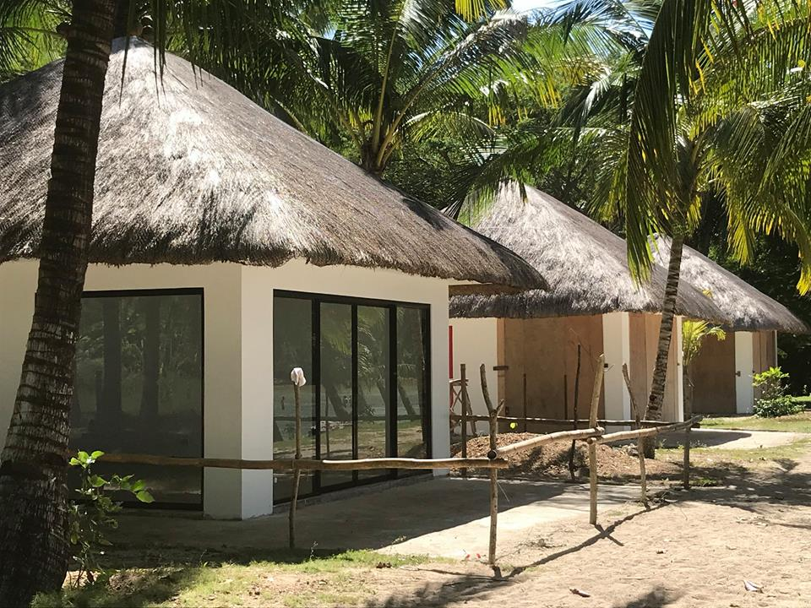

Slide 21
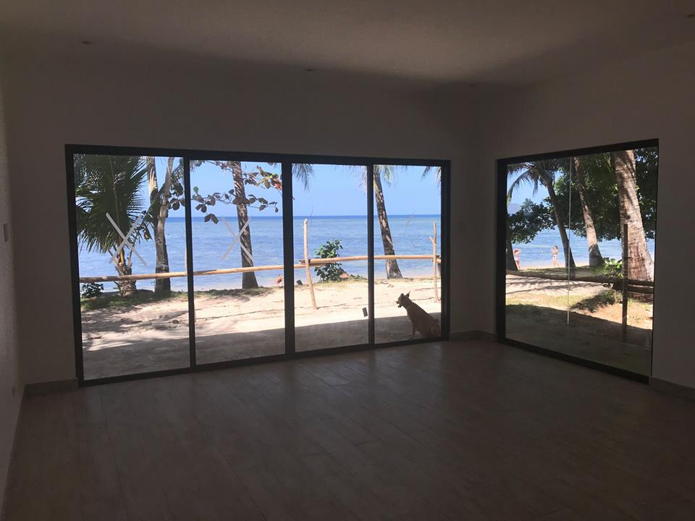

Slide 22
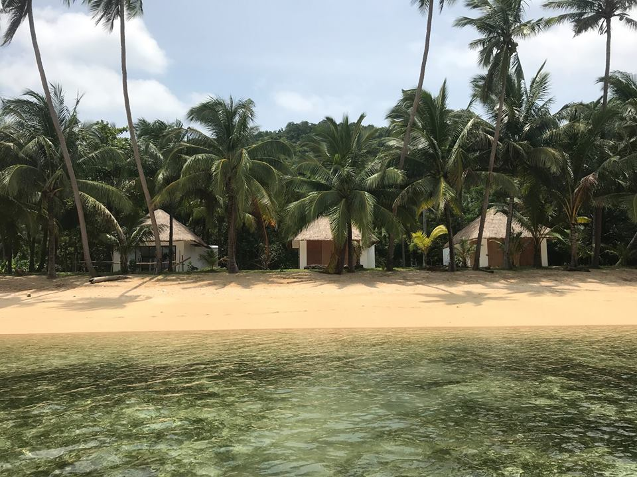

Slide 23
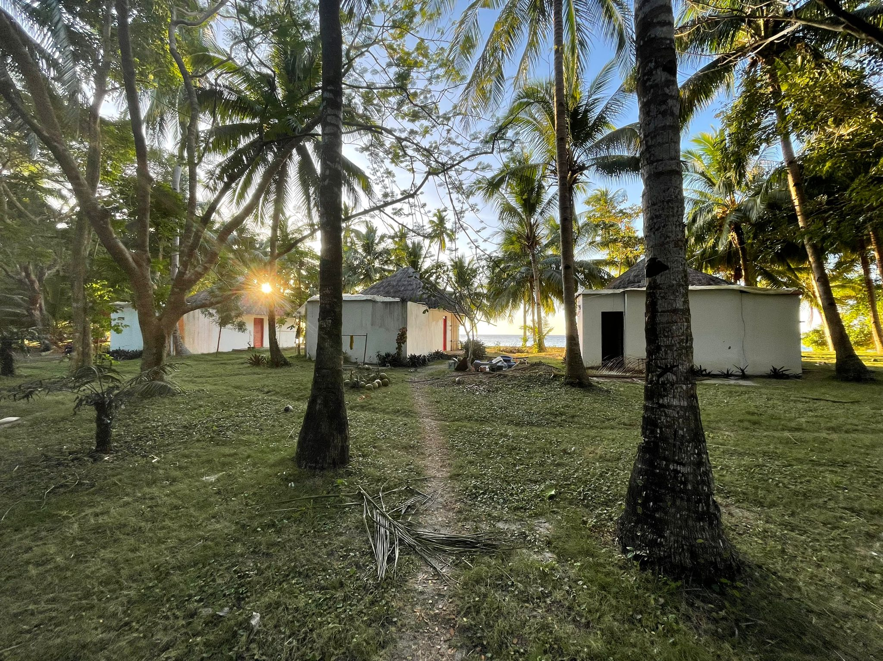

Slide 24
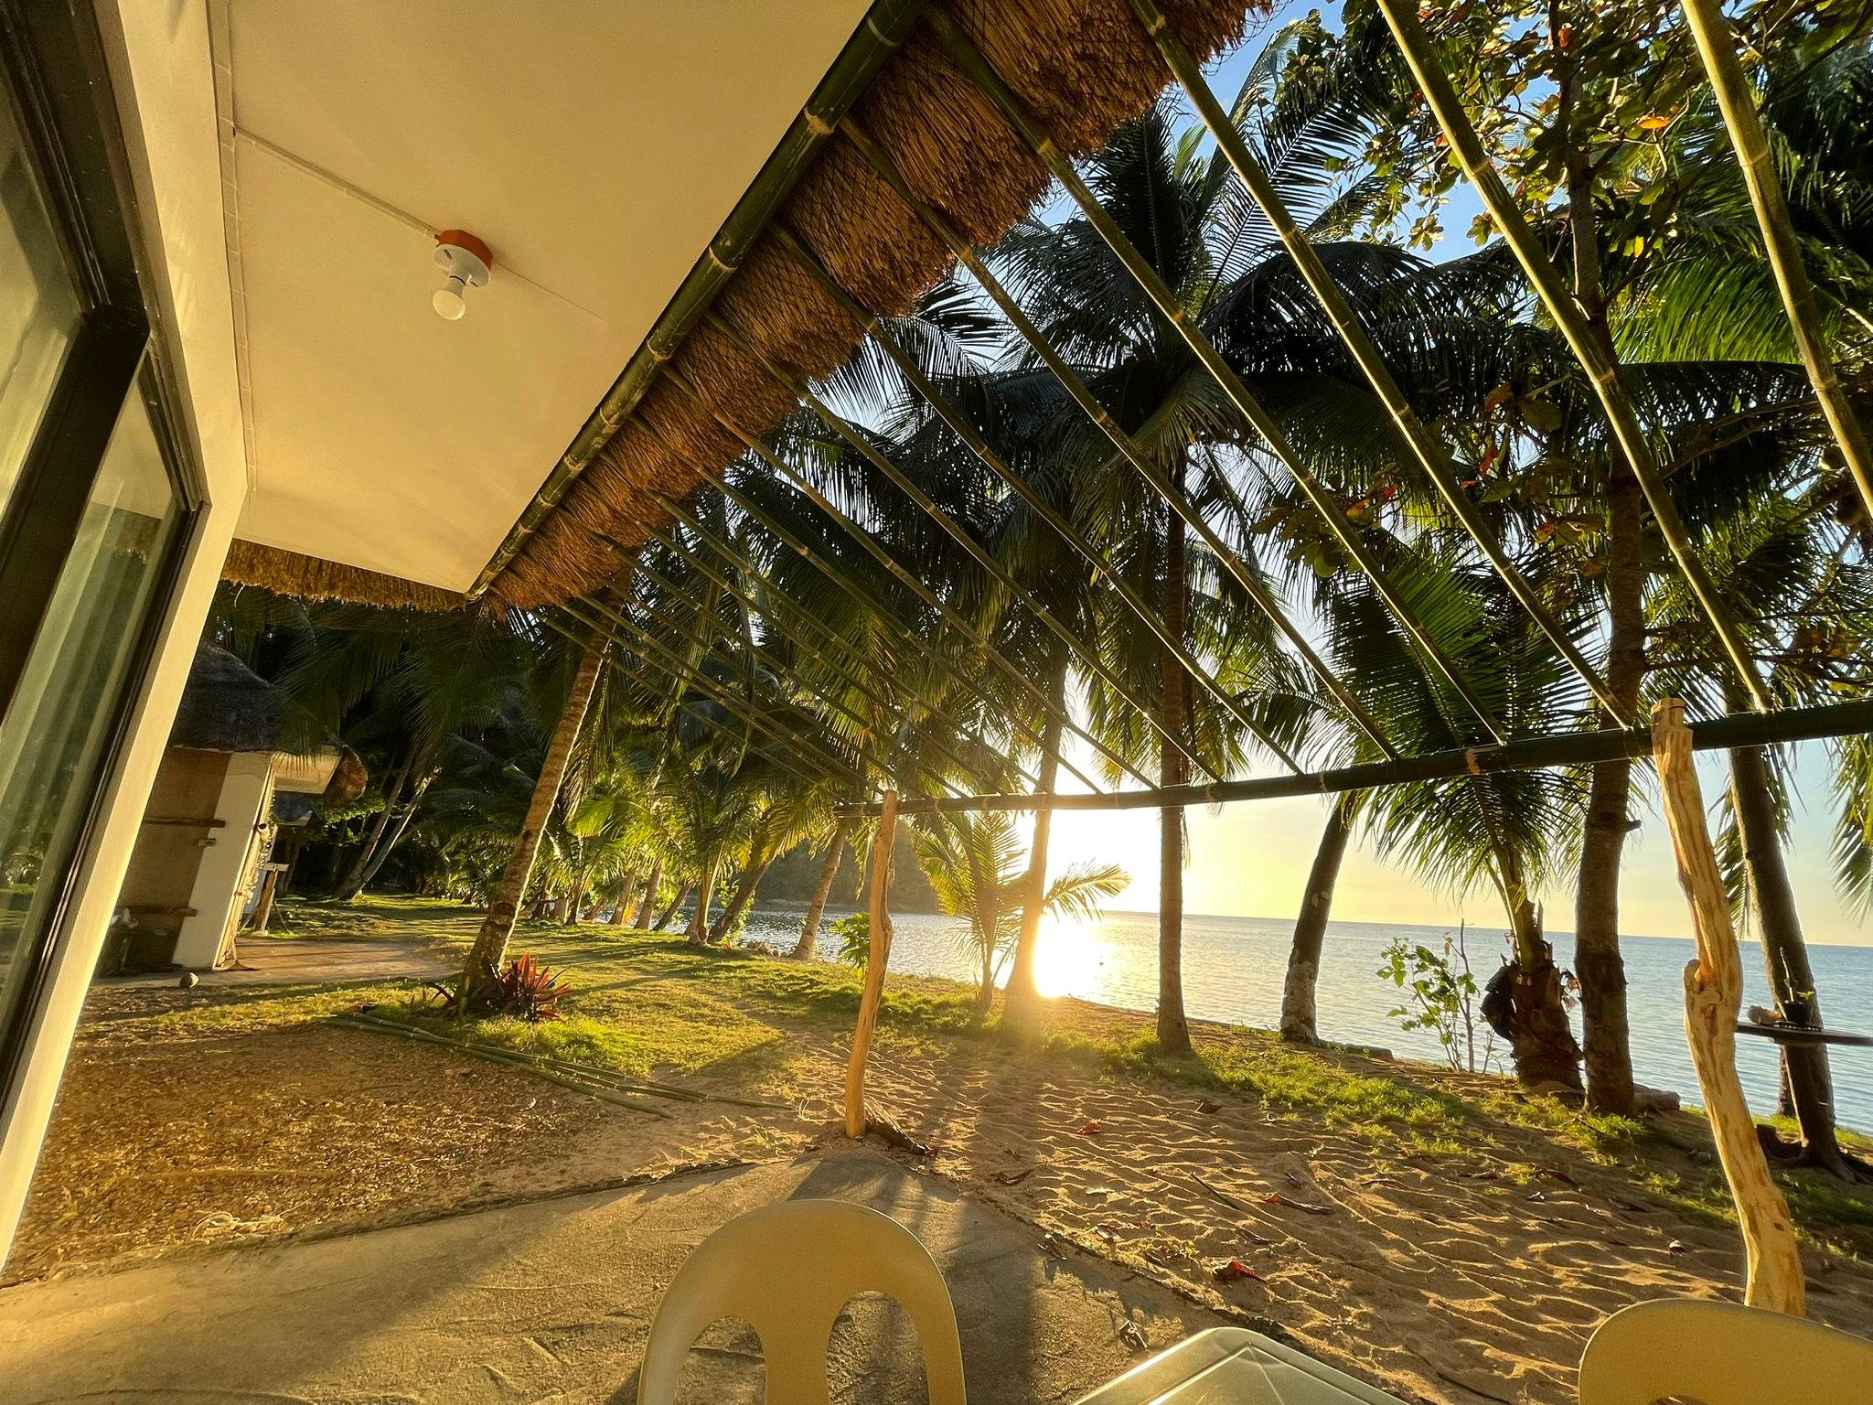

Slide 25
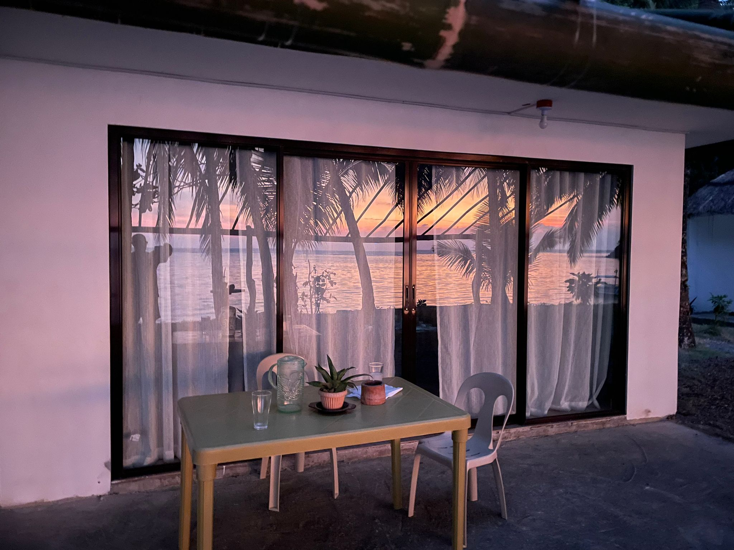

Slide 26
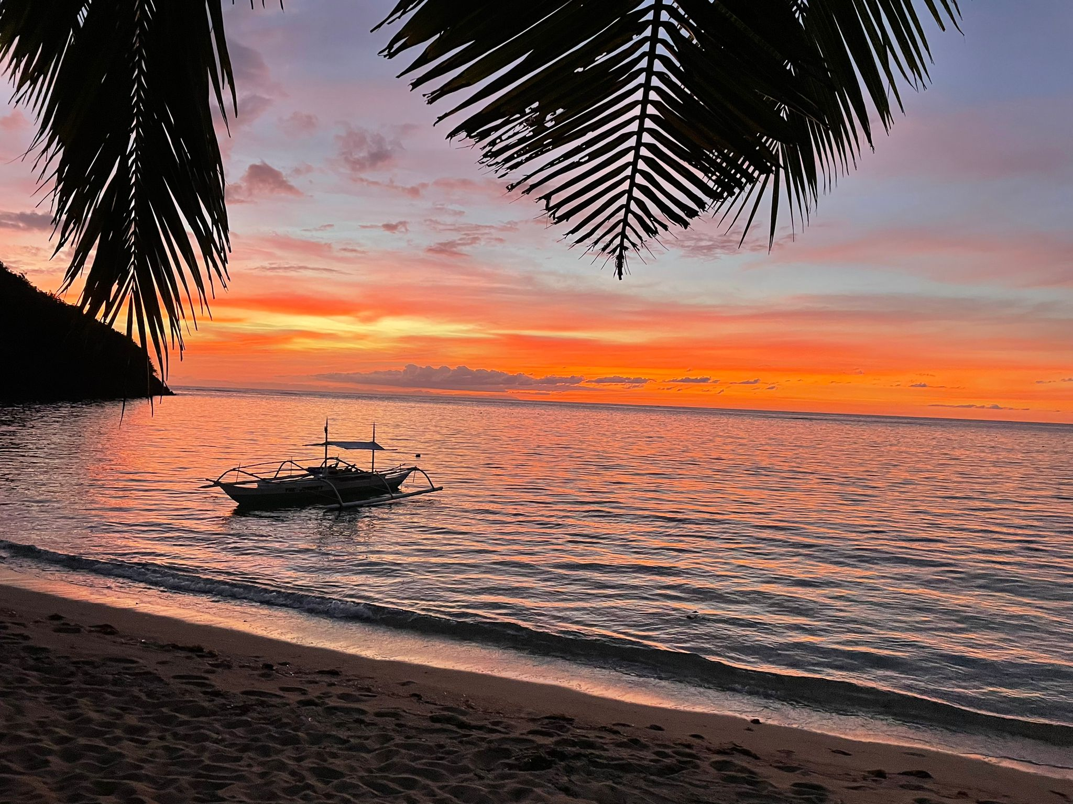

Slide 27
PRICE OF OUR PROPERTY
Palawan is a stunning archipelago that has been ranked as the most beautiful island in the world multiple times. Famous for diving, hiking, beaches, and fishing, this is one of the best tropical travel destinations in Southeast Asia.
In New Busuanga Island, the price of the properties can go up to Php 7,000 per sqm. This promising property however is only Php 3,193.548 per sqm. or Php 99,000,000.00 including complete documentations and building permits that will allow the new owner to start building the resort immediately.

